Slide 1
Decarbonization: Pathways to Carbon Neutrality
Oneil Gayle PE, CEM, CBCP, LEED AP
Chief Operating Officer, Loring Consulting Engineers, Inc
Rachel Kuykendall CEM, LEED AP
Principal Strategic Analyst, PG&E

Slide 2
Oneil Gayle PE, CEM, CBCP, LEED AP
Loring Consulting Engineers, Chief Operating Officer
20 Years Experience in HVAC Design, Energy and Commissioning
ACEC NY Board of Directors
Mechanical Plant Engineering, University of Technology, Jamaica
BS Mechanical Engineering, New York Institute of Technology

Slide 3
Rachel Kuykendall CEM, LEED AP
Principal Strategic Analyst, Decarbonization Strategies, PG&E
10+ years providing energy consulting
5+ years in utility programs and decarbonization
BA Architecture, UC Berkeley

Slide 4
Learning objectives
Inform participants on current legislation on building decarbonization and evaluate potential impact to building owners and design consultants
Explain the role and challenges utility companies face in achieving decarbonization goals using PG&E (California) experience and their strategies for incentivizing decarbonization
Define current strategies and opportunities for building decarbonization and discover resources for further exploration
Identify potential risks associated with decarbonization and suggested ways to assess, analyze and manage the associated risk

Slide 5
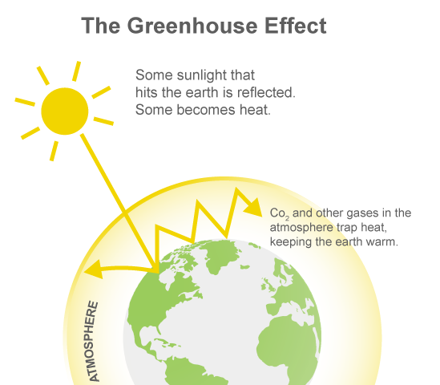
Any gaseous compound in the atmosphere that is capable of absorbing infrared radiation, thereby trapping and holding heat in the atmosphere. Why Carbon?
What is a greenhouse gas?
Source: TeachEngineering.org
Source: TeachEngineering.org

Slide 6
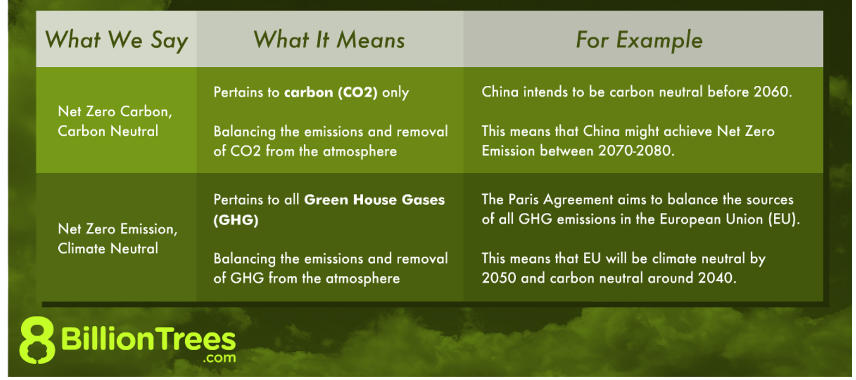
Carbon neutrality
Source:https://8billiontrees.com/carbon-offsets-credits/neutral-certificates/climate-vs-carbon-neutral/

Slide 7
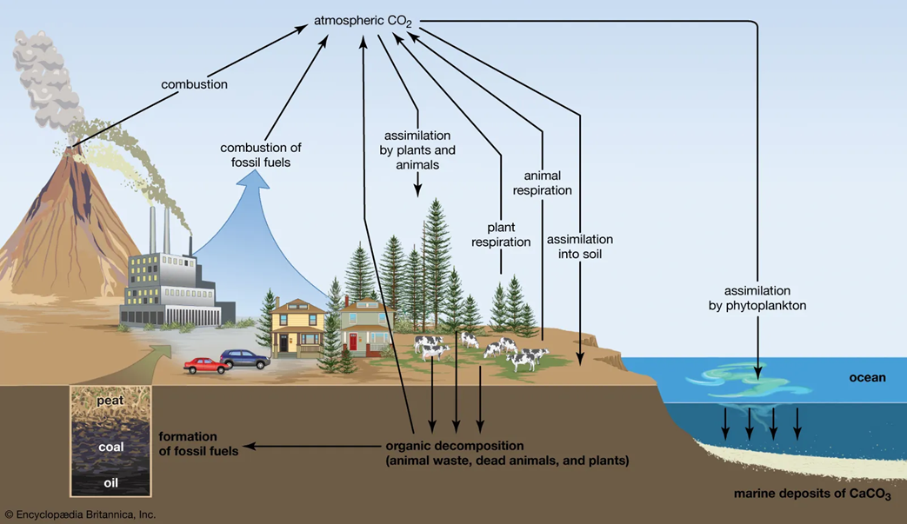
Carbon neutrality
Balance emitting carbon and absorbing carbon
Carbon sequestration (removing and storing)
Carbon sink is any system that absorbs more carbon than it emits (soil, forests and oceans)
Source: https://cdn.britannica.com/19/114419-050-F6658A82/carbon-cycle.jpg.
2020: Global CO2 emissions = 36.0 Gt
Natural sinks CO2 removed = 9.5-11 Gt

Slide 8
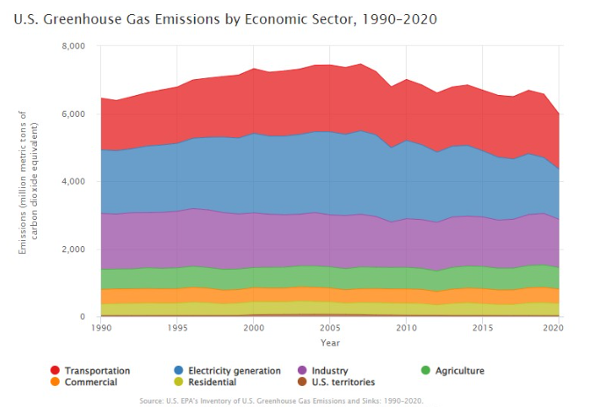
2020 US emissions: 5,981 Million Metric Tons (MMT) of Carbon Dioxide Equivalent (CO₂e). The US is the world’s 2nd highest emitter, and accounts for 11% of the global total.
Greenhouse gas emissions - US
Source: U.S. EPA’S Inventory of U.S. Greenhouse Gas Emissions and Sinks: 1990-2020
Source: US EPA

Slide 9
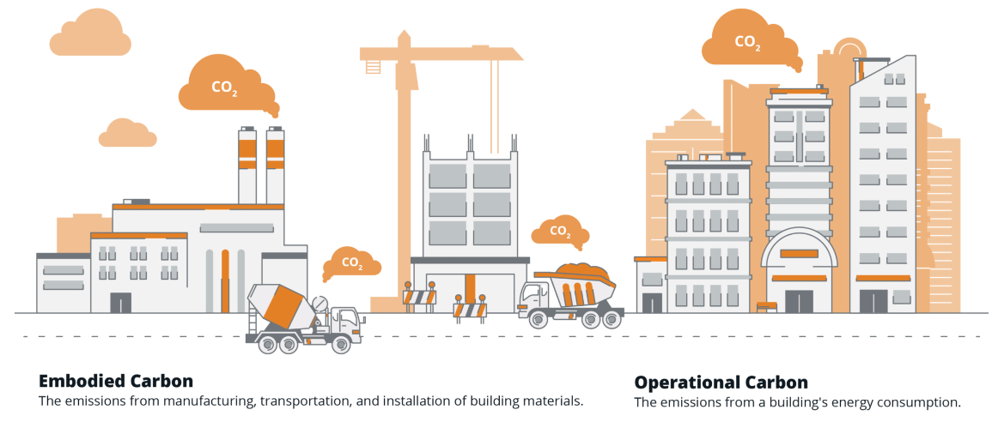
Building carbon sources
Source: https://www.carboncure.com

Slide 10
Embodied carbon in buildings and building materials
39% global energy related carbon emissions
Buildings
28% from operational emissions (energy needed to heat, cool and power
11% from materials and construction
Source: https://www.worldgbc.org/embodied-carbon#:~:text=Buildings%20are%20currently%20responsible%20for,11%25%20from%20materials%20and%20construction.

Slide 11
7 US states have enacted or are in the process of enacting local gas bans and electrification codes in new buildings
Many additional states have recently passed legislation and incentives supporting building electrification and efficiency
Canadian Clean Electricity Regulations target net-zero electric system by 2035 and net-zero emissions by 2050
Washington
HB 1084: all-electric new construction
Vermont
"Renewable heat" in new construction. $20M for incentives to convert existing buildings
Massachusetts
HB 5060: communities empowered to ban fossil fuels in new construction
Nevada
Acknowledged the need to transition from gas use in residential and commercial buildings
Illinois
SB 2408: Stretch building code and electrification in EE programs
Maryland
Climate Bill Legislation passed: Investigate all-electric buildings and net-zero commercial buildings by 2040
California
Eliminates new gas system subsidies starting July 2023
Bans gas water and space heating appliance sales in 2030
Colorado
GHG Pollution Reduction Roadmap mandating heat pump phase in and emissions reductions
Missouri
Building performance standard mandating reductions in building energy usage
Source: GeoNames, Microsoft, TomTom
Notes:
Focus of this slide is that some states have jurisdictions that have banned new gas connections, and in states where gas connections continue to be allowed, building codes and incentives actively pursue building decarbonization
7 states have adopted or are in the process of adopting legislation enacting local gas bans and new building electrification codes
22 states have or are in the process of banning local legislation restricting natural gas service, though building electrification incentives are still encouraged in many cases.
Few examples of recent state legislation to support building electrification and EE
Illinois - SB 2408: Stretch building code and electrification in EE programs
Maryland - Climate Bill Legislation passed: Investigate all-electric buildings and net-zero commercial buildings by 2040
Massachusetts - HB 5060: communities empowered to ban fossil fuels in new construction
Vermont - "Renewable heat" in new construction. $20M for incentives to convert existing buildings
Washington - HB 1084: all-electric new construction
Missouri - Building performance standard mandating reductions in building energy usage
Colorado - GHG Pollution Reduction Roadmap mandating heat pump phase in and emissions reductions
Nevada - Acknowledged the need to transition from gas use in residential and commercial buildings

Slide 12
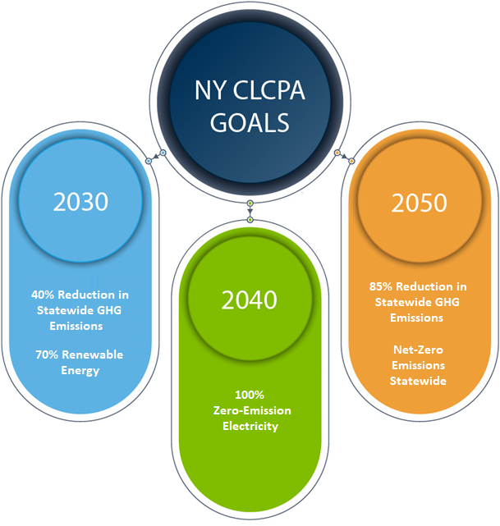
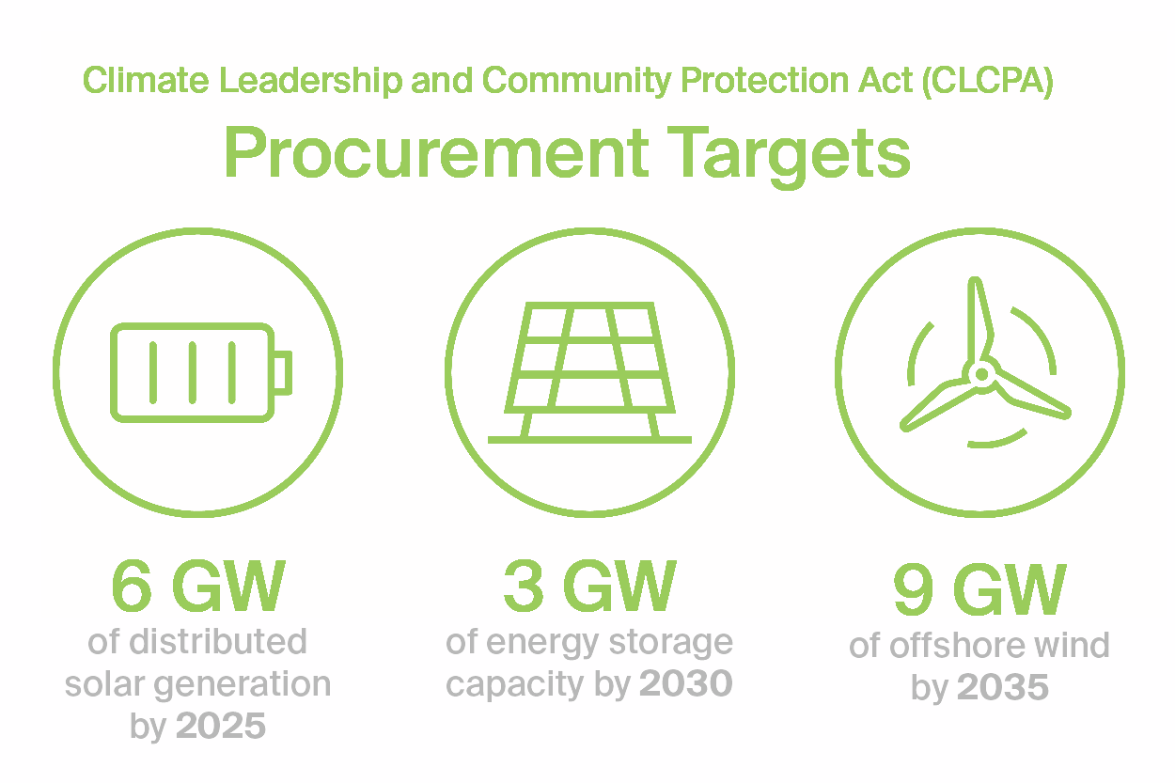
New York State – CLCPA
Climate Leadership and Community Protection Act (2019)
Amongst the nation’s most aggressive climate and clean energy laws
Regulations expected by Jan 1, 2024
Baseline Year for Comparison: 1990
Source: https://www.edisonenergy.com/blog/new-york-energy-series-intro/
Source: An Introduction to the NY Climate Leadership and Community Protection Act Draft Scoping Plan | Wendel (wendelcompanies.com)
)

Slide 13
New York City laws
Local Law 97
Penalties for exceeding building carbon emission limits
Emission limits defined for 2024-2029 and 2030-2034
Applicable to buildings 25,000 SF and above
Penalties targeting worst 20% from 2024, and worst 70% from 2030
Local Law 92
Local Law 94
Buildings must cover available roof area with solar PV and/or green roof
Must install green roof if solar not feasible, and vice versa
In effect immediately for new construction and existing roof extensions
Trigger for existing buildings – replacement of entire roof assembly
Local Law 154
Prohibits fossil fuel systems in new buildings and gut renovations

Slide 14
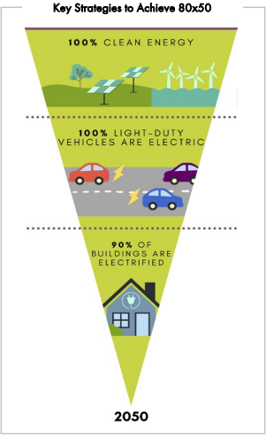
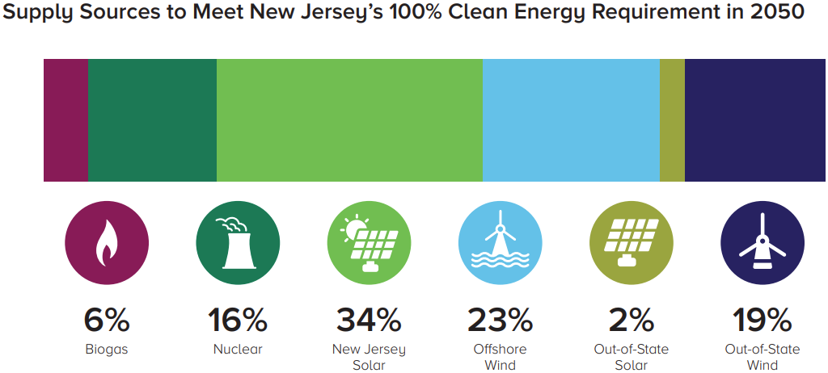
New Jersey – GWRA
GWRA – Global Warming Response Act (2007)
Target – Reduce GHG emissions 80 percent from 2006 levels by 2050
2019 Energy Master Plan called for 100% Clean Energy by 2050
Source: 2019 New Jersey Energy Master Plan – Pathway to 2050
Source: nj.gov

Slide 15
Through Executive Orders and then Legislation, CA has established statewide GHG targets for 2020, 2030, and 2045; CA aims to achieve carbon neutrality by 2045 and maintain net negative GHG emissions thereafter
Assembly Bill 32 (2006)
Reduce to 1990 levels by 2020
Senate Bill 32 (2016)
40% below 1990 levels by 2030
Assembly Bill 1279 (2022)
85% below 1990 levels &
carbon neutral (remaining emissions balance by removals) by 2045
Source: Statewide emissions data from 2019 CARB GHG Inventory

Slide 16
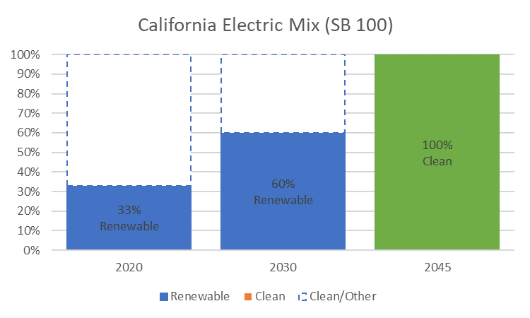
California’s decarbonized electric system
Source: Data is sourced from California Energy Commission 2021 Total System Electric Generation: 2021 Total System Electric Generation (ca.gov)
Source: Data is sourced from 2021 SB 100 Joint Agency Report: Charting a path to a 100% Clean Energy Future
Notes:
CA’s decarbonized electric system supports GHG emissions reductions as alternative fuel sources are transitioned to electric
Over half of CA’s power mix in 2021 was clean.
SB 100: “The 100 percent Clean Energy Act of 2018” updates states RPS standard to ensure 60% renewable electricity by 2030, 100% by 2045
RPS Eligible Resources: Solar, wind, geothermal, biomass, and small hydro
PG&E’s electric mix in 2021 was 93% clean/GHG free – nearly 90% cleaner than the nation average among energy providers

Slide 17
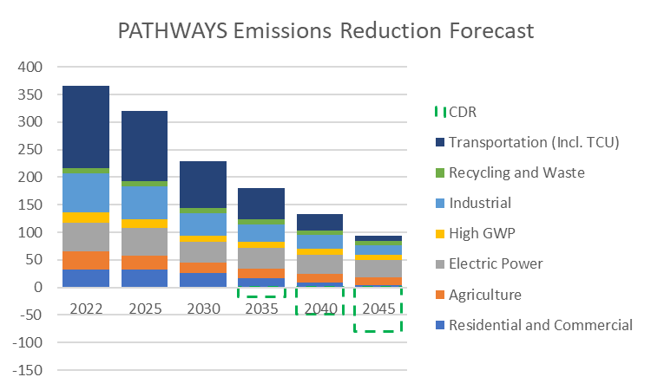
Residential and commercial buildings are important to reaching carbon neutrality
Source: Data sourced from CARB PATHWAYS scenarios
Notes:
To attain climate goals, all sectors must take steps to reduce GHG emissions
When buildings and electric sector electrify, the impact is compounded due to cleaner electricity replacing emitting fuel usage
In unmitigated, residential and commercial buildings would represent over 25% of total GHG emissions in the otherwise carbon reduction scenario

Slide 18
Building electrification objectives
35 + cities in PG&E’s service territory have issued all-electric new construction targets in
15-25 cities in PG&E’s service territory are considering electrification retrofit targets pending further analysis
Source: Statewide emissions data from 2019 CARB GHG Inventory
Notes:
Sept 22, 2022: CARB bans use of gas heaters and furnaces by 2030, which would further accelerate these forecasts

Slide 19
Transportation electrification objectives
EO accelerates the State’s EV goals and increases the need for infrastructure to support EV adoption. PG&E modeling indicates ~10-40 sites need to be built per day through 2030 for light-duty alone
Light Duty: 100% ZEV sales by 2035
Med/Heavy Duty: 100% ZEV operations by 2045
Illustrative Path to 100% ZEV operations by 2045
PG&E Forecast
PG&E Forecast
Organic Growth
Meets Current Regulation
37% of market
Source: PG&E

Slide 20
Solar PV
Energy Efficiency, Demand Response, then Solar PV
Source: PG&E
Notes:
Solar PV can help offset load increases by building electrification. Adding EE and DR in addition to Solar PV can further improve peak building demand and reduce the size of necessary electric services

Slide 21
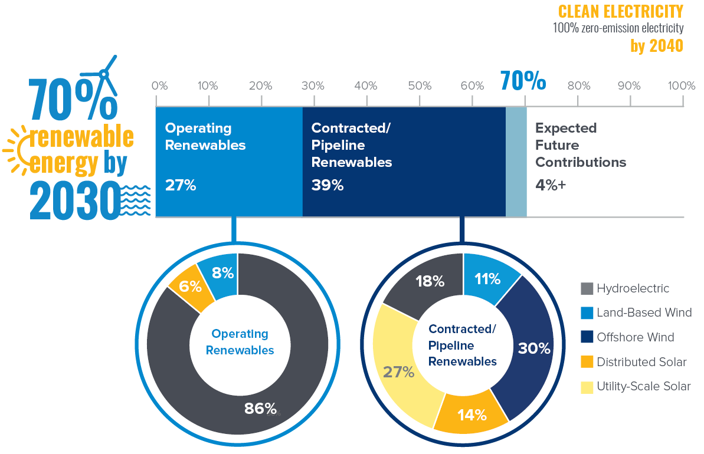
After
Tier IV
Source: NYSERDA Progress Toward Renewable Energy Goals
Notes:
Discuss Renewable energy in general
Existing renewables: Hydropower (run of river, impoundment, etc.), land-based wind, and distributed solar ~ 27%
Progress towards CLCPA targets: Increase in building Large Scale Renewables (Wind, Solar)
Projects under contract/construction put us at 66% total today - growing to 70% by 2030 thanks to Tier I, Tier IV, OSW
New York currently has more than 120 renewable energy projects under development, including large-scale solar, land-based and offshore wind, and transmission projects awarded under Tier 4. Once these projects are completed, 66 percent of the State’s electricity will come from renewable sources, well on the way to the goal of 70 percent renewable energy by 2030.

Slide 22
Decarbonization planning resources

Slide 23
Decarbonization planning resources
ASHRAE
NBI
Source: https://newbuildings.org/
Source: https://www.ashrae.org/technical-resources/aedgs/zero-energy-aedg-free-download

Slide 24
Decarbonization additional planning resources
Source: https://passivehouseaccelerator.com/passive-house/what-passive-house-standards
Source: https://sustainableinfrastructure.org/
envision-v3-one-year-anniversary/
Source: https://www.usgbcwm.org/home/
logo-leed-round_v3/

Slide 25
Source: U.S Green Building Council 2020

Slide 26
Source: U.S Green Building Council 2020

Slide 27
California and federal incentives for building decarbonization
California
$622.4M to retrofit existing buildings and $300M in rebates from Governor’s budget for clean heating
$120M to incentivize adoption of low-emissions space and water heating technologies in existing single and multifamily homes
Up to $2M in incentives per applicant to adopt all-electric technologies in new, low-income all-electric homes
Federal inflation reduction act
$4.5B in grants for points of sale rebates for customers switching to all electric
$4.3B in grants to develop and implement an energy-performance rebate for home retrofits
Up to $14,000 per household for electrification costs (e.g., $1,750 for heat pump water heater)
*Not an exhaustive list of incentives
Notes:
can we estimate the “pot of money” available from each program (in round terms), and then do something with the slide that shows the magnitude of funding available from each program? The names of the programs are less important than the idea that there are fund available.

Slide 28
Decarbonization – challenges
Electric grid reliability issues – need almost 3 times renewable capacity addition to substitute capacity from traditional power plants
Grid electricity emission factor is a dynamic number that will keep changing and difficult to predict. Emission factor will go down with renewable energy addition to the grid, but will go up with any nuclear plant decommissioned
Electrification will require large capital investment – both at generation and consumption levels
Incentives will be required for electrification of single/multi-family homes

Slide 29
Decarbonization – risk awareness
The risk of doing nothing?
Climate change
Penalties
ESG impacts
Communication
Grid capacity
Gas price forecast
$$

Slide 30
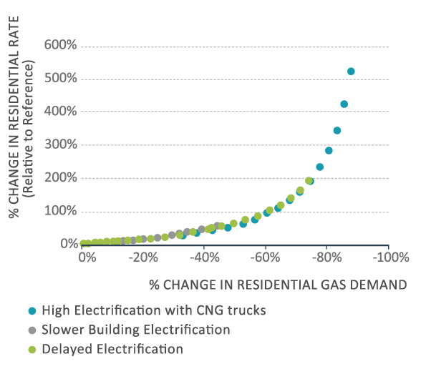
Impacts of decline in gas demand on rates
Source: Figure 4 from California’s Gas System in Transition: Equitable, Affordable, Decarbonized And Smaller
Notes:
The relationship between reductions in residential gas demand and gas rates is initially fairly linear (a 10% reduction in demand increases rates by about 10%), but if demand falls by more than 40% residential rates start to increase much more rapidly

Slide 31
Discussion/ questions

Slide 32
Legal Notice and Disclaimer
The information contained in this presentation is protected by U.S. and International Copyright laws. Reproduction and/or distribution without DPRCG’s written permission is prohibited. © 2022 Design Professional Risk Control Group. All rights reserved.
The information contained herein is intended for informational purposes only. Insurance coverage in any particular case will depend upon the type of policy in effect, the terms, conditions and exclusions in any such policy, and the facts of each unique situation. No representation is made that any specific insurance coverage would apply in the circumstances outlined herein. Please refer to the individual policy forms for specific coverage details.
AXA XL is a division of AXA Group providing products and services through three business groups: AXA XL Insurance, AXA XL Reinsurance and AXA XL Risk Consulting.
In the US, the AXA XL insurance companies are: AXA Insurance Company, Catlin Insurance Company, Inc., Greenwich Insurance Company, Indian Harbor Insurance Company, XL Insurance America, Inc., XL Specialty Insurance Company and T.H.E. Insurance Company.
In Canada, insurance coverages are underwritten by XL Specialty Insurance Company - Canadian Branch. Coverages may also be underwritten by Lloyd’s Syndicate #2003. Coverages underwritten by Lloyd’s Syndicate #2003 are placed on behalf of the member of Syndicate #2003 by Catlin Canada Inc. Lloyd’s ratings are independent of AXA Group.
Not all insurers do business in all jurisdictions nor is coverage available in all jurisdictions.

